Slide 1
RISC-V DEBUG SECURITY

Slide 2
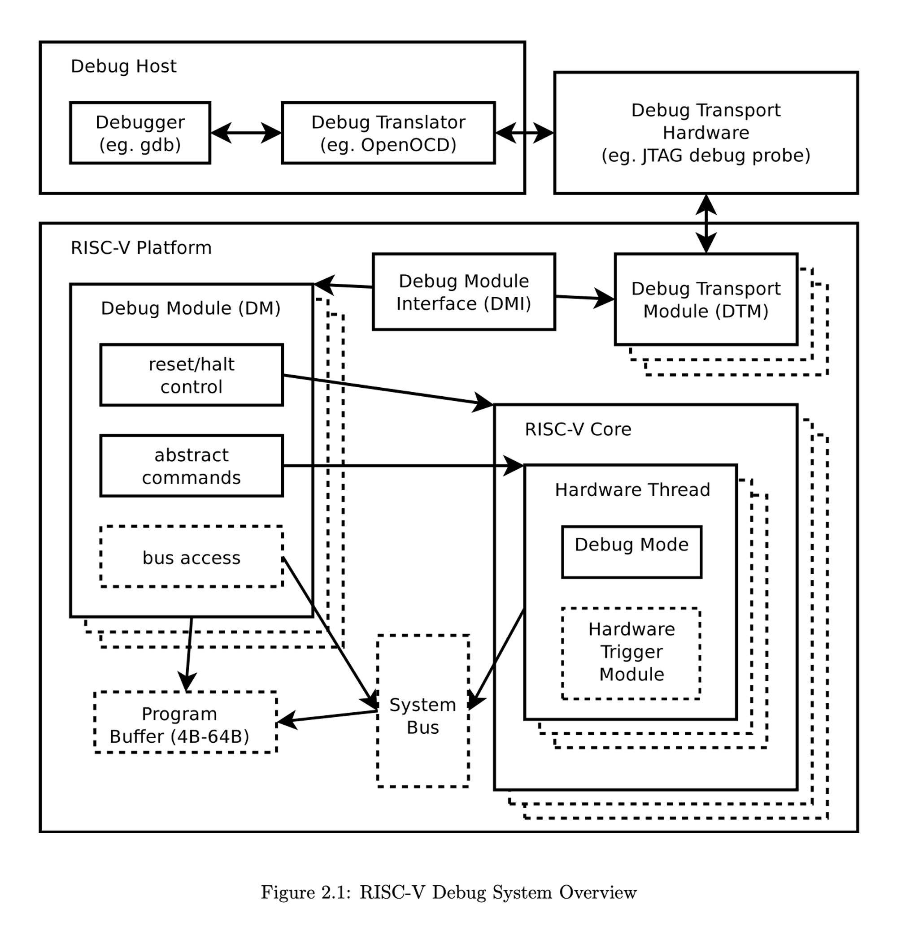
RISC-V EXTERNAL DEBUG

Slide 3
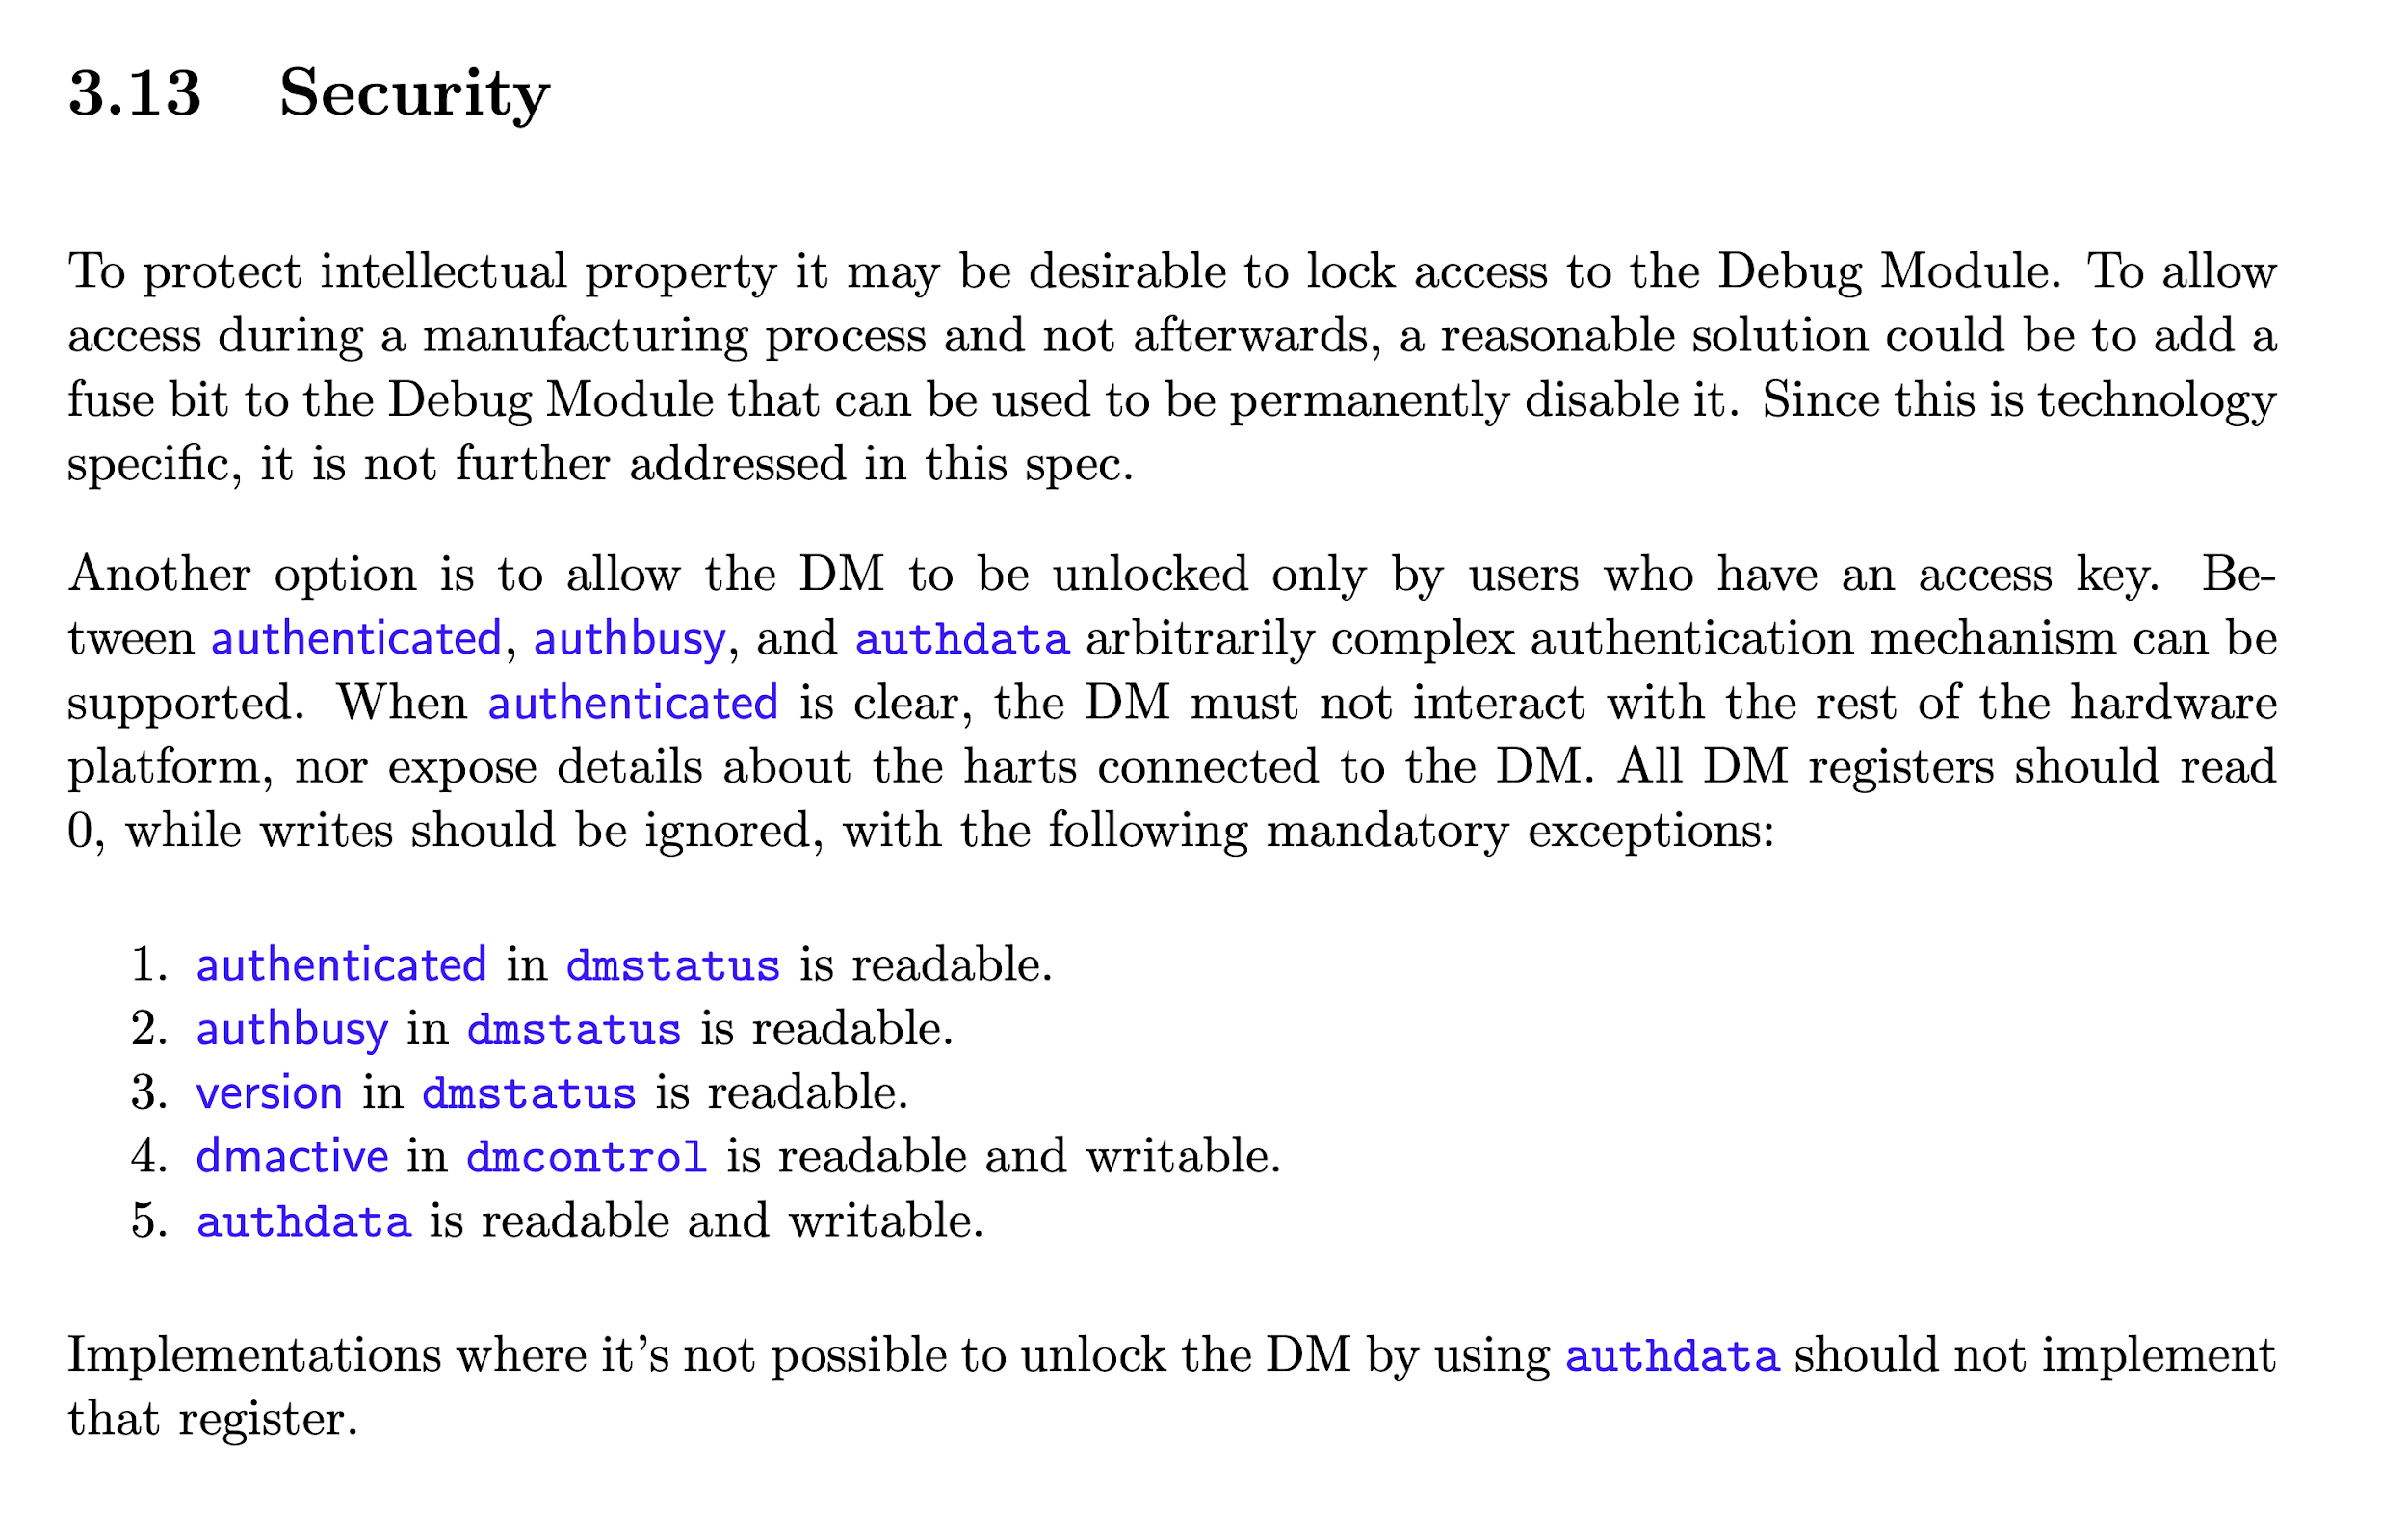
RISC-V DEBUG SECURITY
All-or-nothing, controlled via fuse or authdata and authenticated
Once enabled, external debugger has highest priority regardless of target privilege

Slide 4
THE ISSUE
Debug
Module
DMI/DTM
High-Secure
Domain
Non-Secure
Domain
S-mode
PMP
Once enabled, external debugger has highest privilege regardless of target privilege
A non-secure FW developer who can use debugger to debug non-secure FW can compromise high-secure FW and M-mode monitor
M-mode Monitor
M-mode
Debug
mode
Program buffer

Slide 5
RISC-V DEBUG SPEC SECURITY ISSUES
Debug access to system bus
Without any protection (IOPMP), debugger can access to M-mode data
Execute abstract commands
Access register - Permission check always performed as if the core is in M mode regardless of target privilege
Access memory - Permission check always performed as if the core is in M mode regardless of target privilege
Programming buffer
Debugger can write arbitrary code into programming buffer
Programming buffer code executes in debug mode

Slide 6
RISC-V DEBUG SPEC SECURITY ISSUES
Debug mode (M minus one mode!!!)
Permission check always performed as if the core is in M mode regardless of target privilege
Permission can be further relaxed by relaxedpriv (bypass PMP.L)
Halt / resume / reset the hart

Slide 7
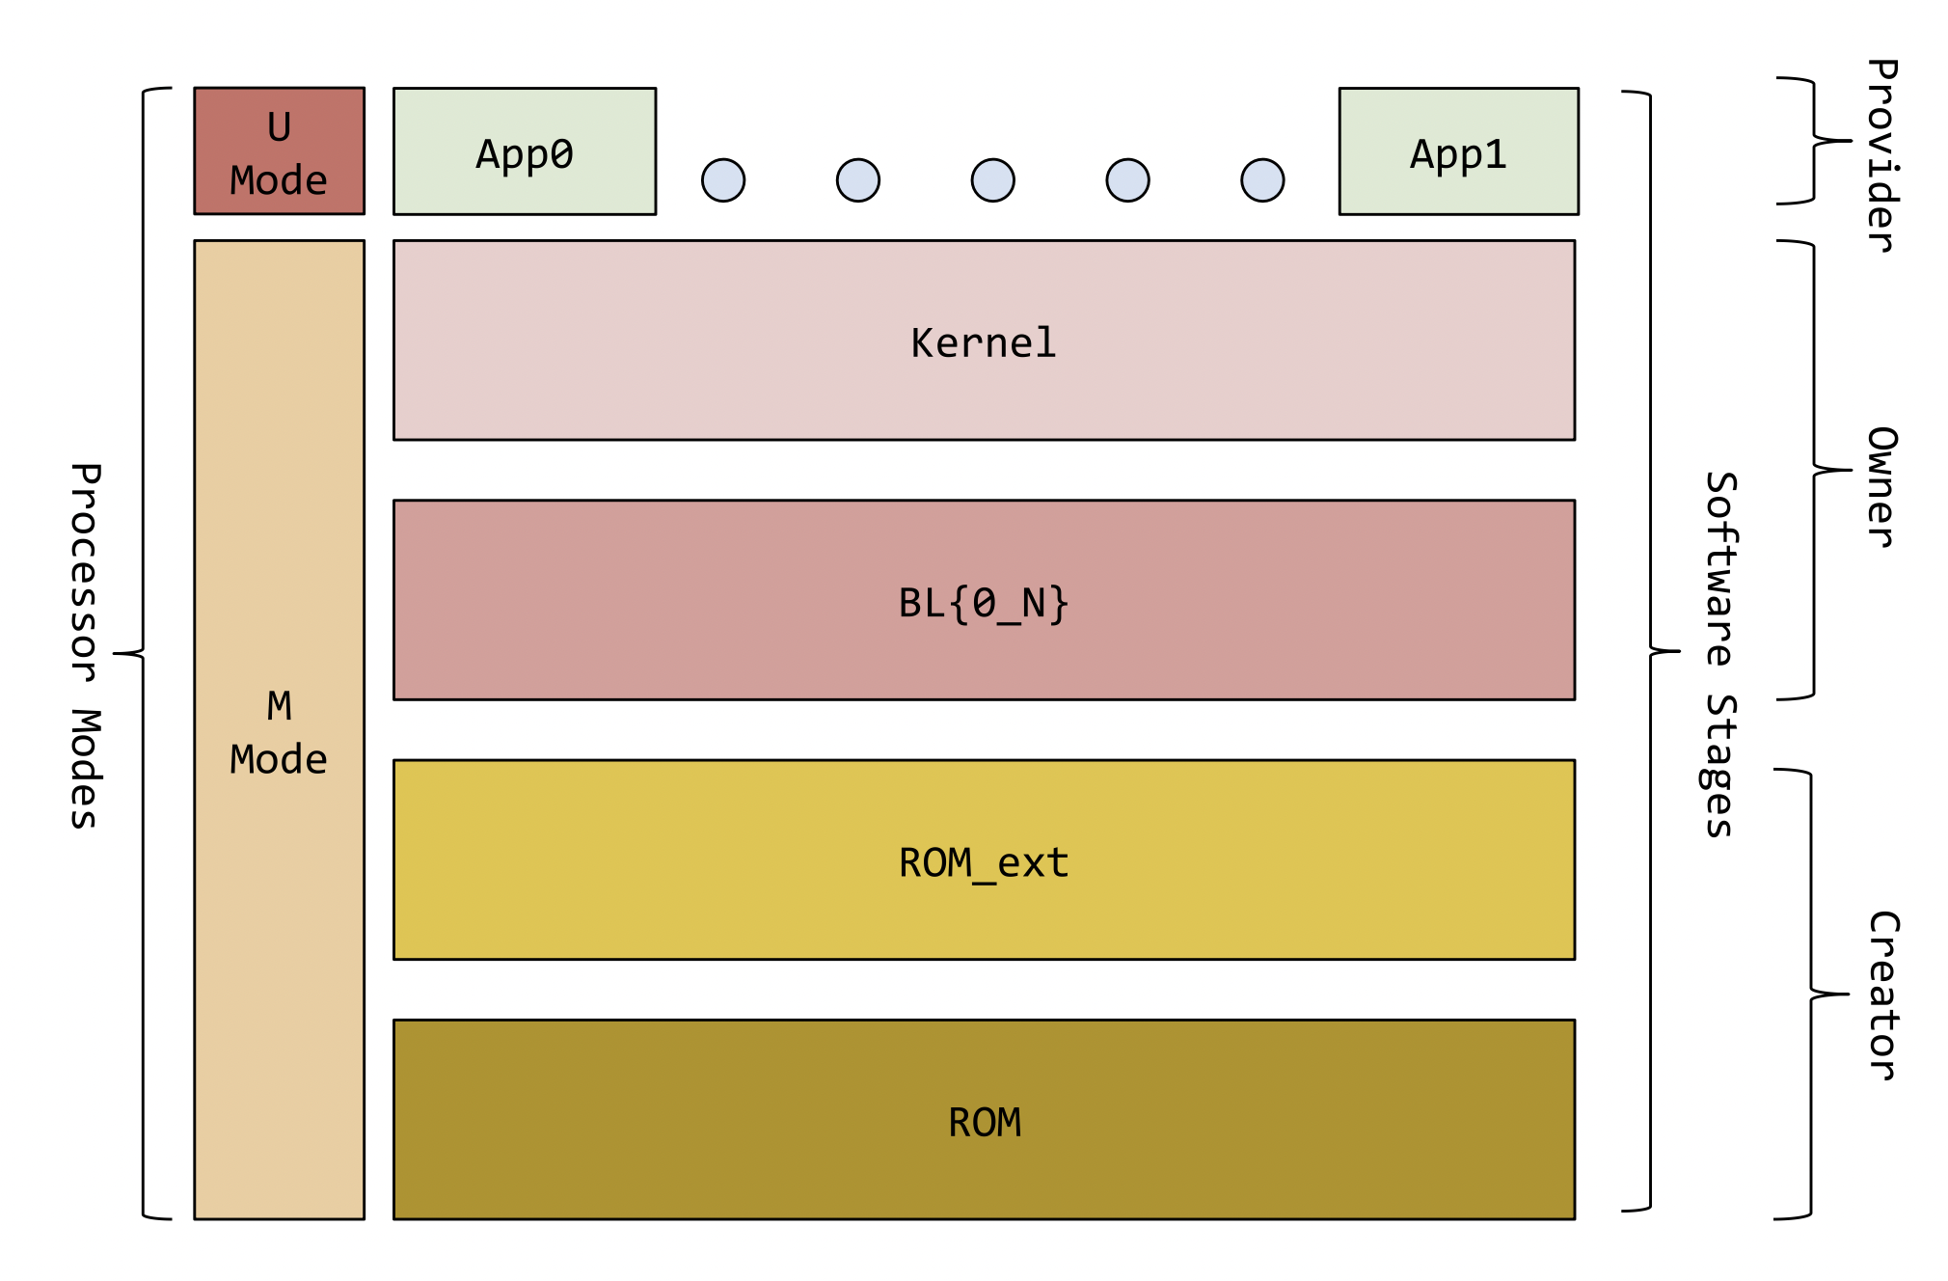
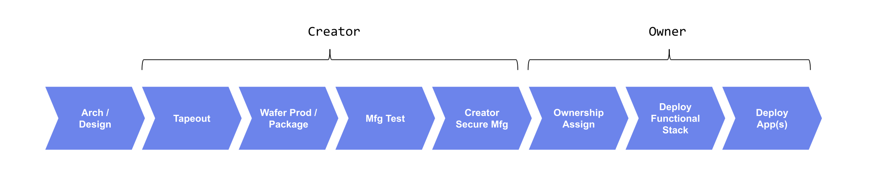
WHY THIS IS A PROBLEM?
Modern SOC software development consists of multiple actors, they both need external debug
One actor wants to protect its confidential data from another actor (Silicon creator considers Silicon owner adversary)
Disable debug for best security!
I need to debug my software!
Silicon Creator
SOC
Silicon Owner
System
App
Provider
Image copied from OpenTitan

Slide 8
WHY THIS IS A PROBLEM?
App
App
App
App
U-mode
There’s strong requirement to protect high security domain’s data even within one actor, to reduce TCB
In this example we want to protect management domain or M-mode monitor from low security domain (RTOS) when using external debugger to debug RTOS
Disable Debug!
MMU
Management
Domain
RTOS
Rich OS
S-mode
PMP
Enable Debug!
M-mode Monitor
M-mode

Slide 9
EXAMPLE
OEM attack SOC vendor
Debug
Module
DMI/DTM
SOC Vendor
Code/Data
OEM
Code/Data
S-mode
Adversary
OEM (or SOC vendor)
Asset
SOC vendor (or OEM) code/data
The attack
SOC vendor code/data shall be confidential to OEM and vice versa. However, an OEM (or SOC vendor) developer who has debug access to OEM code can break PMP protection and steal SOC vendor (or OEM) confidential code/data
PMP
M-mode monitor
M-mode

Slide 10
EXAMPLE
ROM Dump
Hart #1
M-mode
Hart #2
M-mode
Debug
Module
DMI/DTM
Debug mode
Debug
memory access
PMP.L=1
PMP.L=1
Debug mode
bypass PMP.L
via relaxedpriv
Adversary
Firmware developer
Asset
ROM code
The attack
Boot ROM code shall be confidential to firmware developer. A firmware developer who has external debug access can bypass PMP.L protection to read ROM content, assuming BR protection relies on PMP.L
BR
FW Code/Data

Slide 11

EXAMPLE
Debug
Module
DMI/DTM
1k LOC
<5 ppl
10k~100k+ LOC
100+ ppl
DRM Service FW
Codec FW
S-mode
Adversary
Non-secure code developer
Asset
Class keys (e.g. hdcp master key)
The attack
Class key shall be confidential to non-secure partition. However, an attacker who has debug access to the non-secure partition can steal class key via external debugger
PMP
M-mode monitor
M-mode
500 LOC
<5 ppl

Slide 12
COMPETITOR ANALYSIS - ARM
ARMv8 provides rich mechanisms to protect secure data from debugger access
Controls secure / non-secure / realm separately
Controls invasive / non-invasive debug separately
Controls external debug and self-hosted debug separately
Controls halting debug events sperately
Consists of both hardware or software
Debug access to memory/register honors target privilege level, hence no privilege escalation

Slide 13
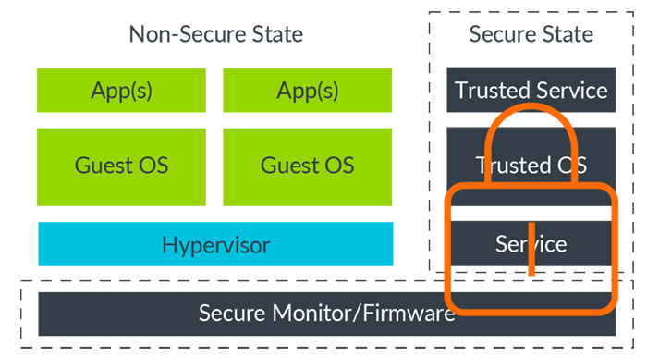
ARM TARGET STATE
An Armv8-A architecture processor or core can have two security states, Secure state and Non-secure state. If the Secure state is implemented, privileged or secret information for the SoC is stored or handled through the Secure state. This means that, after a certain point in the development cycle of an SoC, the hardware or software will lock untrusted users out of the Secure state. This step is taken to prevent access to the protected data in the Secure state.
This diagram shows hardware or software locking a user out of the Secure state:
If you try to connect a debugger to an SoC that uses this operational model, then the debugger will only allow you to connect to the Non-secure state.
Notes:
https://developer.arm.com/documentation/102408/0100/Target-state

Slide 14
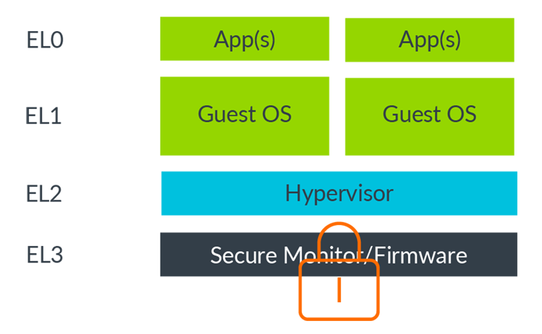
ARM TARGET STATE
SoC designs can lock users out of certain Exception levels either through hardware or software. This locking usually occurs late in the development cycle of the SoC, so that unprivileged users cannot access aspects of the code or SoC design. This diagram shows an SoC in which EL3, which is usually where the secure monitor and firmware reside, is locked.
If you connected a debugger to an SoC that uses this operational model, then you could debug EL2, EL1 and EL0, but not EL3.
Notes:
https://developer.arm.com/documentation/102408/0100/Target-state

Slide 15
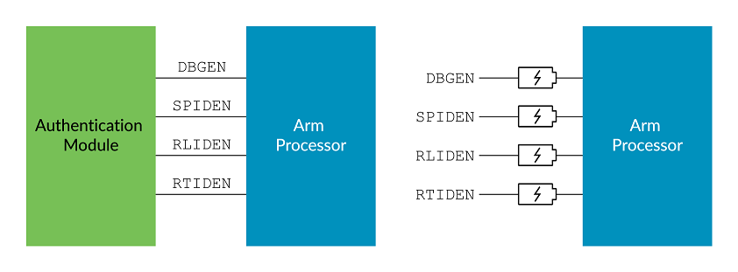
EXTERNAL DEBUG CONTROL
DBGEN: Top-level invasive debug enable
NIDEN: Non-secure invasive debug enable
SPIDEN: Secure invasive debug enable, controls external ability to debug in secure state
SPNIDEN: Secure non-invasive debug enable, controls external ability to non-invasive debug in secure state
RLPIDEN: Realm Invasive Debug Enable, controls external ability to debug in realm state
RTPIDEN: Root Invasive Debug Enable, controls external ability to debug in root state
Notes:
Learn the architecture - Realm Management Extension (arm.com)

Slide 16
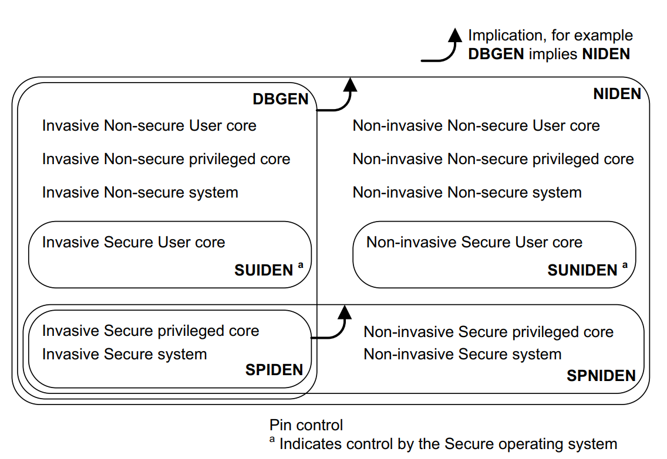
USER MODE DEBUG
Individual components can offer greater control over the permitted level of debugging. For example, some processors implementing Arm Security Extensions can grant permission to debug-specific Secure processes by permitting debugging of Secure User mode without permitting debugging of Secure privileged modes.
Controlled via SDER (Secure Debug Enable Register)

Slide 17
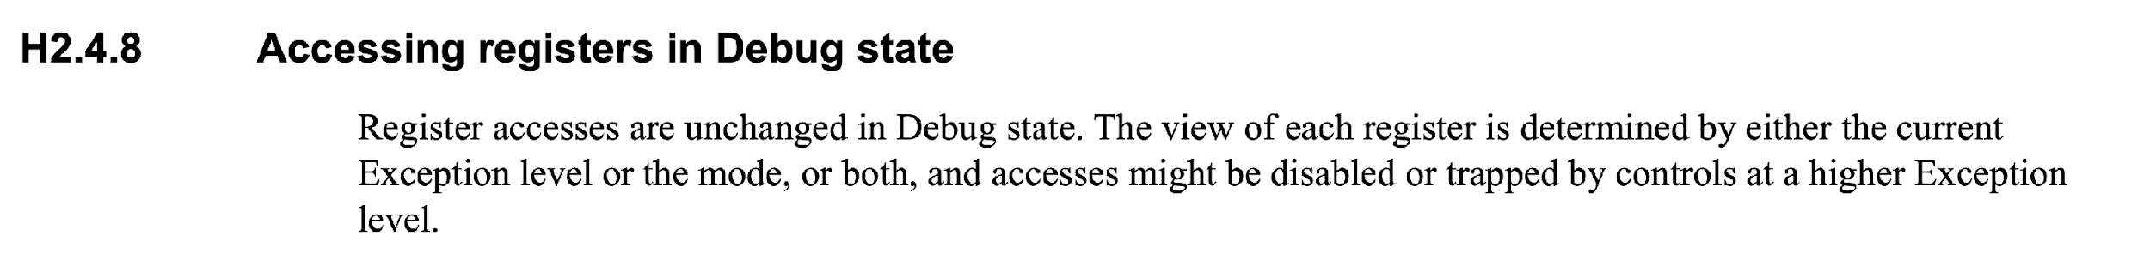
ACCESSING REGISTER IN DEBUG STATE
ARM DDI 0487J.a ID042523 a-profile_architecture_reference_manual H2-11113

Slide 18
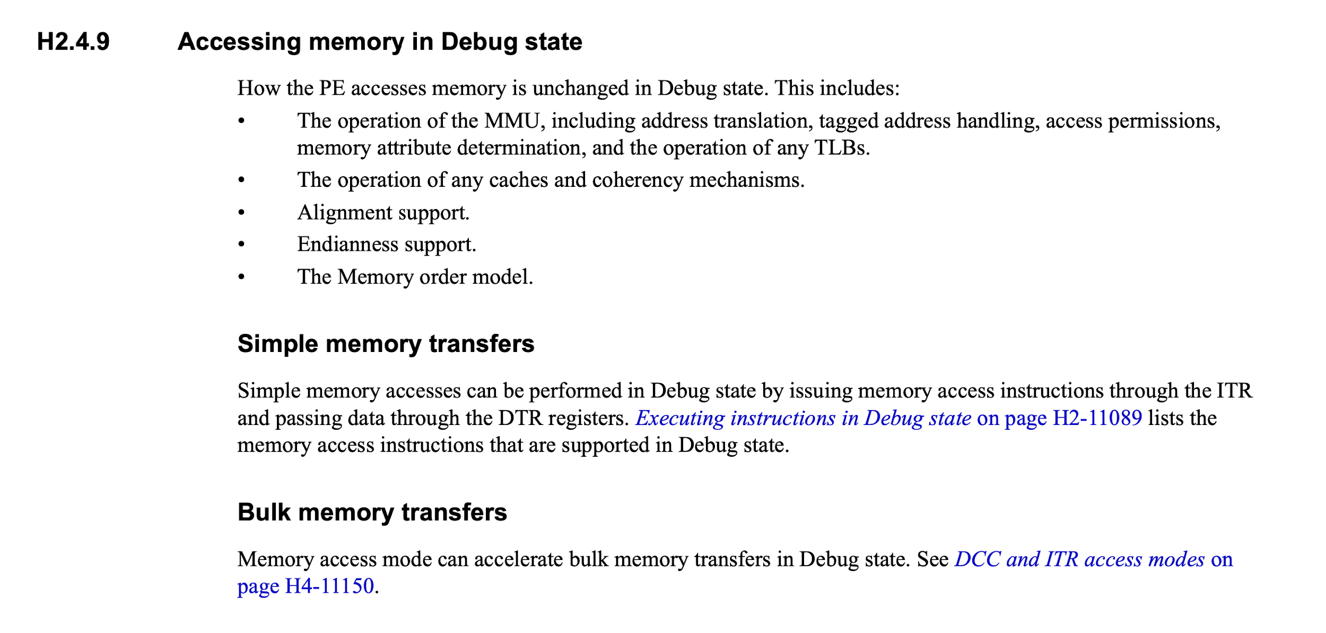
ACCESSING MEMORY IN DEBUG STATE
ARM DDI 0487J.a ID042523 a-profile_architecture_reference_manual H2-11115

Slide 19
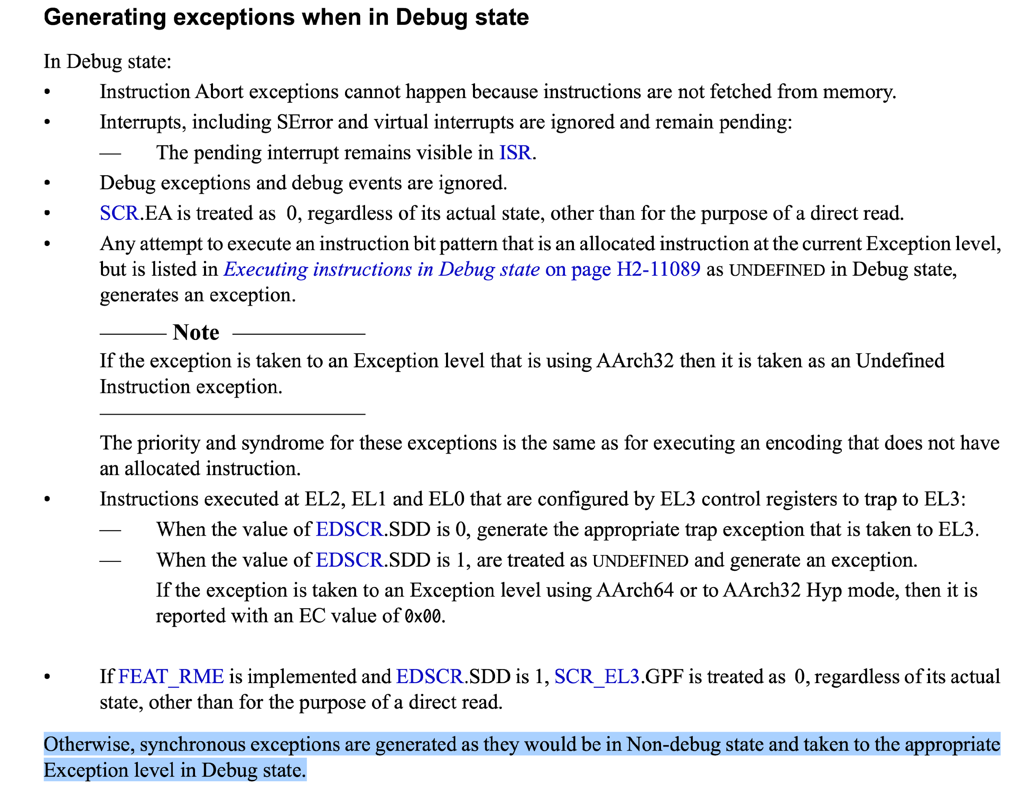
EXCEPTION IN DEBUG STATE
ARM DDI 0487J.a ID042523 a-profile_architecture_reference_manual H2-11110

Slide 20
CALL FOR ACTION
We believed the use case and security requirements are general, all RISC-V SOC vendors will face the same problem sooner or later
It turns out that the security issues are addressed by competitor (ARM)
NVidia had been using homegrown debug solution because of those security issues
We call for RISC-V security community to acknowledge the issues and work together on an extension to fix the issues
NVidia RISC-V team is working on a draft proposal
Enable/disable external debug at M/S/U mode separately
Restrict permission check of debug mode
Restrict permission check of abstract commands
Restrict permission check of program buffer execution
Restrict system bus accesses from external debugger (IOPMP)

Slide 22
REFERENCE
ARM Architecture Reference Manual Security Extensions Supplement
https://developer.arm.com/documentation/ddi0601/2023-03/External-Registers?lang=en
https://developer.arm.com/documentation/ddi0487/latest/
https://developer.arm.com/documentation/102120/0101
Notes:
ARM Architecture Reference Manual Security Extensions Supplement

